Slide 1
WIRELESS VEHICLE (V2V) COMMUNICATIONS
THE UNIVERSITY OF TEXAS
MEMBERS: RICARDO ALANIS, LUCAS CASTRO, BRANDON MARZIK, BRADLEY OLBREY
SPONSOR: ROLAND VARRIALE

Slide 2







OVERVIEW
BACKGROUND
PROJECT FOCUS
APPROACH
PROGRESS
WORK TO BE DONE
ISSUES ENCOUNTERED

Slide 3



VEHICLE TO VEHICLE COMMUNICATION
With the increase of autonomous cars and smarter vehicles the protocol they use to communicate critical information needs to be defined.
Vehicles would be able to exchange speed information, location information, direction, and emergency information while in operation.
These operations would later be pulled into exchanging information with the infrastructure of the road and information pulled from pedestrians.

Slide 4
DEDICATED SHORT-RANGE COMMUNICATION
DSRC is one-way or two-way short-range to medium-range wireless communication channels specifically designed for automotive use.
An amendment was made to the IEEE 802.11 standard to include enhancements to support intelligent transportation systems (ITS).
This involves data exchanges between high speed vehicles and the road side infrastructure using DSRC.
This amendments licenses the 5.9 GHz band (5.85-5.925 GHz) to be dedicated for this purpose. This is also known as 802.11p.

Slide 5
PROJECT FOCUS
The 802.11p specification in the IEEE standard is pretty bare at the moment.
There are no security specifications for the protocol currently built into it.
Our goal is to attempt an a basic DDOS attack to see the practicality of an attack against the V2X system.

Slide 6
THREAT SCOPE
The attackers has no ability to modify any system currently operating in the ecosystem.
  Has no physical access or wireless access to any system i.e. cars, RSU, traffic lights etc.
The attacker can only introduce new devices to the network that add information to the network.
  Can introduce their own RSU to the system.

Slide 7



APPROACH
Use the Veins framework with OMNeT++ to simulate an attack against wireless communicating vehicles.
Introduce a new device to the network (malicious road side unit) to conduct an attack inside the ecosystem.
The two techniques we are attempting is to send a large amount of messages to overload the network or increase the gain of the radio to send messages that overpower other messages causing them to be distorted.

Slide 8
PROGRESS
Learning the OMNeT++ and Veins framework.
Learn how to operate the SUMO traffic simulator.
Get a working simulation working under normal conditions.

Slide 9
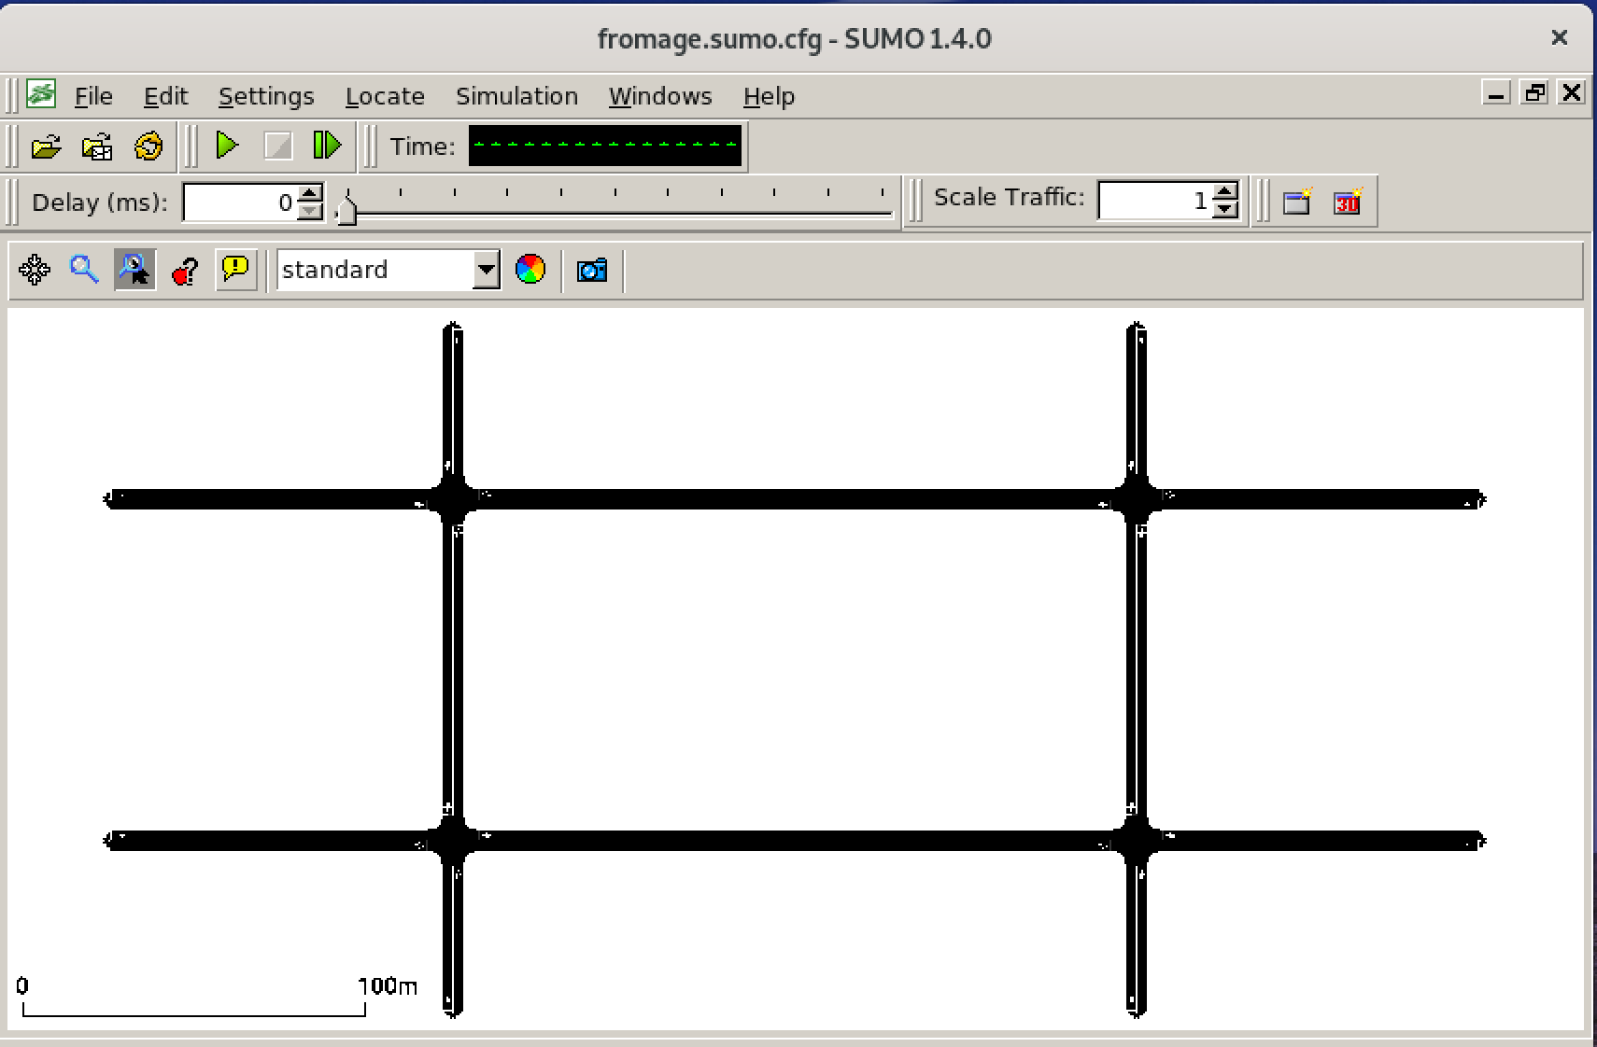
PROGRESS

Slide 10
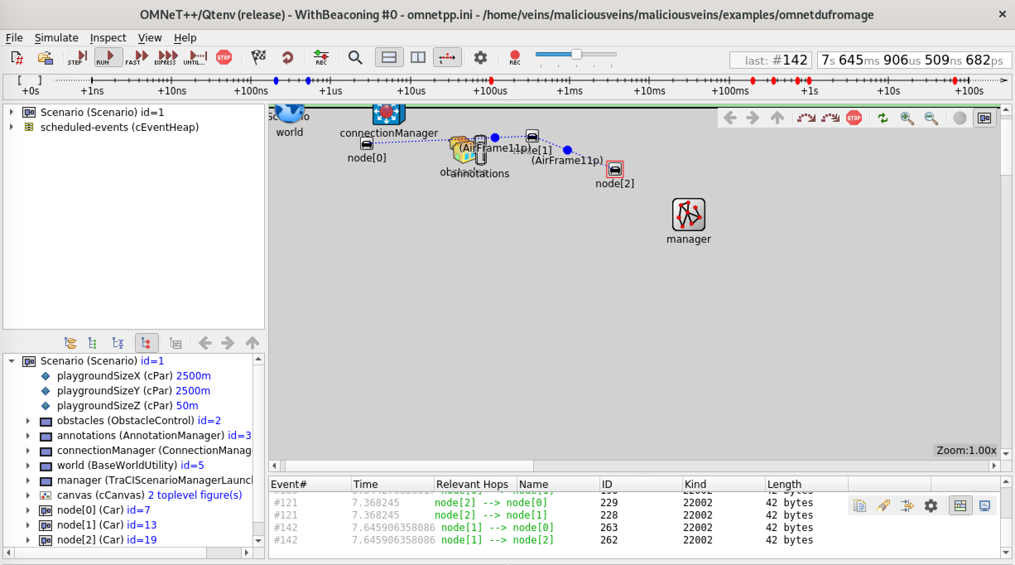
PROGRESS

Slide 11


WORK TO BE DONE
GET A WORKING RSU INSIDE OF THE SIMULATION.
PROGRAM THE DDOS ATTACK INTO THE SIMULATION.
EXPERIMENT WITH THE MESSAGES AND THE GAIN OF THE RADIOS.

Slide 12
ISSUES ENCOUNTERED
Not a lot of documentation for using Veins.
OMNeT++ is not very straight forward.
Limited knowledge with radios.

Slide 13
REFERENCES
https://en.wikipedia.org/wiki/Dedicated_short-range_communications
https://www.extremetech.com/extreme/176093-v2v-what-are-vehicle-to-vehicle-communications-and-how-does-it-work

